Slide 1
Sonja Dörfler-Bolt
Parental Labour in Austria and Sweden
(De-)Genderization in Care and Leave Policies between 1990 and 2023
18.04.2024

Slide 2
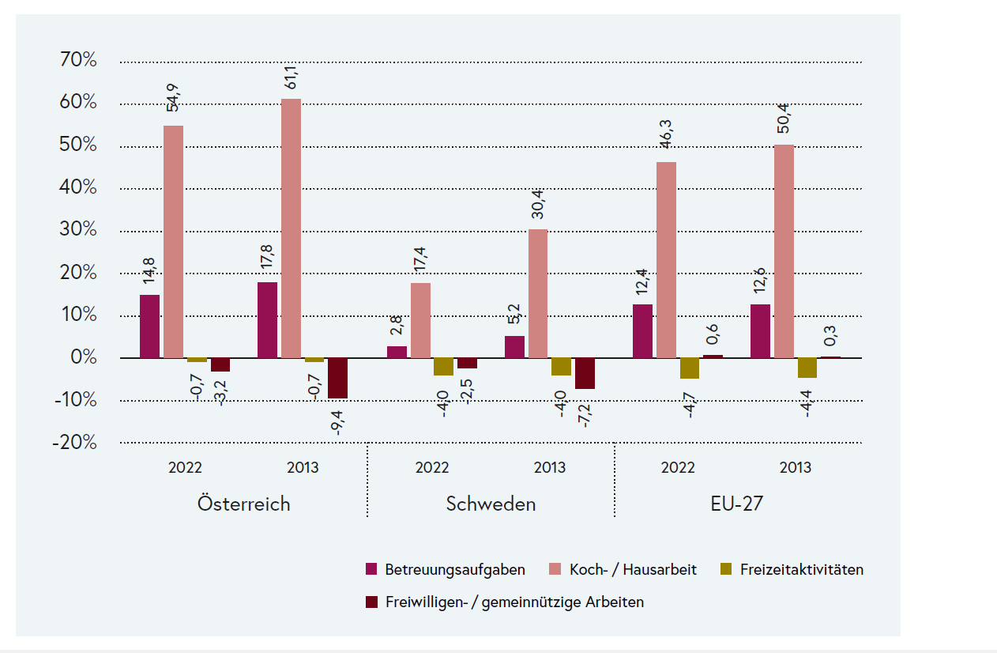
Gender Gap in different activities, in Austria, Sweden and average of the EU-27, 2022 und 2013
Source: Gender-Statistics (EIGE 2023). Differenz der Anteile von Frauen und Männern in der Gesamtbevölkerung ab 18 Jahren

Slide 3
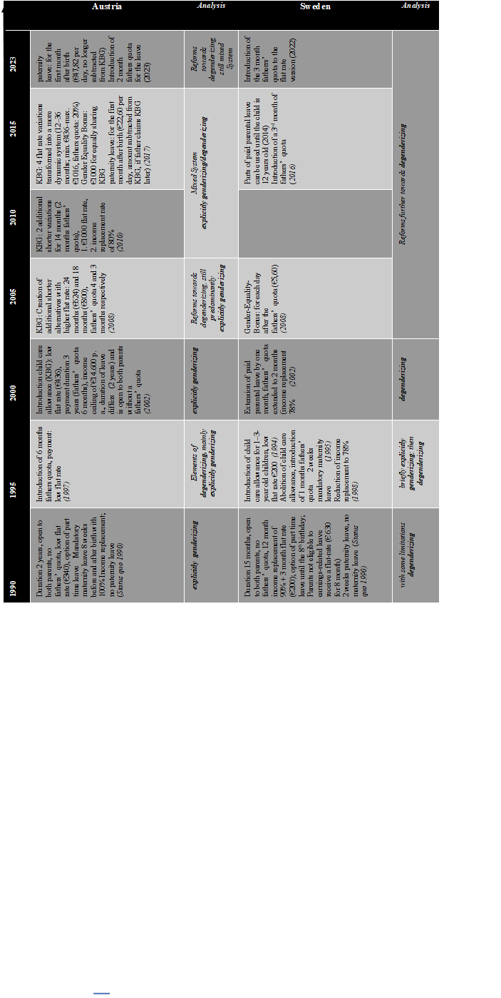
Analysing the development of parental leave regulations, Austria and Sweden, 1990–2023
Sources: Dörfler (2019), Ekberg, Eriksson & Friebel 2005, Ellingsaeter (2012), Ellingsaeter & Leira (2007), Martin-Korpi (2007), retrieved from http://oif-fpdb.oif.univie.ac.at/Login; https://www.leavenetwork.org/annual-review-reports/country-reports/.
Notes:
By 1990 the Swedish policies however were mostly degenderizing, with some restrictions. There was no maternity leave and the parental leave offered a high income replacement (90%) with a relatively short duration (12 months). For parents not eligible for the earnings related leave, received a relatively low flate rate amount for 8 month. The restrictions emerged due to the lack of a fathers’ quota, apart from 10 days of paternity leave following the birth. By the mid-1990’s there were multiple changes in government which leading to a few turns in policies. The first of which happened in 1994 via the introduction of a child care benefit for parents who look after the child at home. It was open to mothers and fathers and payed a low flat rate (without a fathers’ quota) from the first to the third birthday of the child (following the already existing leave allowance). Although this policy was leading towards explicitly genderizing, it did not last long. The following year the child care benefit was abolished by a new government. This government was also the first in the world to introduce a fathers’ quota (one month out of 12, with high income replacement). This made the Swedish leave policies clearly degenderizing.
In 1997 Austria then followed with the introduction of a 6 months fathers’ quota, which was per se degenderizing. As it was combined with a low flat rate payment, it discouraged fathers to share the leave. Due to this the Austrian policies at that time were still mostly explicitly genderizing.
From 1995 onwards Swedish leave policies were becoming ever more degenderizing. In 2002 a second month of fathers’ quota was brought in. Come 2008 and a gender equality bonus for each day of fathers leave over and above the fathers’ quota was introduced. Gender equality bonuses are a relatively new part of leave policies and have not been taken into account in Saxonberg’s typology. We consider them degenderizing in our analyses, although we suggest, that their effects should be subject to further research. In 2017 the fathers’ quota was extended further to 3 months and in 2022 the 3 month of fathers’ quota was also introduced for the flat rate leave (for parents who are not eligible to the earnings related leave, because they haven’t had any earnings prior birth).
In the meantime Austrian leave policies followed a different path. In 2002 the child care allowance (Kinderbetreuungsgeld, KBG) was introduced. This reform was explicitly genderizing as it paid a low flat rate (€436 a month) for a long period (up to 3 years). The allowance did include a fathers’ quota (6 months out of 36), but the leave itself did not and lasted only 24 months.
The first reforms of the KBG took place in 2008. They offered slightly more degenderizing options besides the explicitly degenderizing variation. While the original version of the KBG was still available (3 years, low flat rate), two additional flat rate variations with a higher benefit and shorter duration were implemented (18 months €800 and 24 months €624). These also included a fathers’ quota (3 and 4 months respectively). The leave however was still devoid of a fathers’ quota, which minimized the degenderizing effect remarkably. Mothers could still stay at home for the entire two years without sharing the leave with the father. Furthermore, the financial incentive for fathers was still very limited. On the whole, leave policies in Austria at that time were still explicitly genderizing. Two years later another two variations of the KBG were introduced. This was a definite step towards degenderization. They both offered 14 months KBG including 2 months fathers’ quota with a higher payment. For lower incomes it paid a high flat rate (€1000 per month), for higher incomes 80% income replacement. After this reform Austrian leave policies were a mix of explicitly genderizing and degenderizing. In 2017 the flat rate variations were transformed into a more dynamic system that remains in place to this day. The durations for the allowances range from 14 to 36 months and pay between €436 and €1016 with the fathers’ quota being 20%. The income replacement variation remains unchanged. In the same year Austria announced a gender equality bonus that pays €1000 as long as the KBG is shared fairly equally (minimum 40% taken by the father). Additionally in 2017 a month of paid paternity leave after the birth of the child was introduced, but the amount was subtracted from the KBG of the father, which had a negative effect on the take up fathers’ leave. In 2023 a policy change should eliminate this negative affect as the month of paternity leave, taken directly after birth, is now no longer subtracted from the KBG. Since the current reforms the leave policies In Austria remain a mixed system of both: explicitly genderizing and degenderizing, even though further steps have been made to make them more the latter.
Directive (EU) 2019/1158 of the European Parliament and of the Council of 20 June 2019 on work-life balance for parents and carers

Slide 4
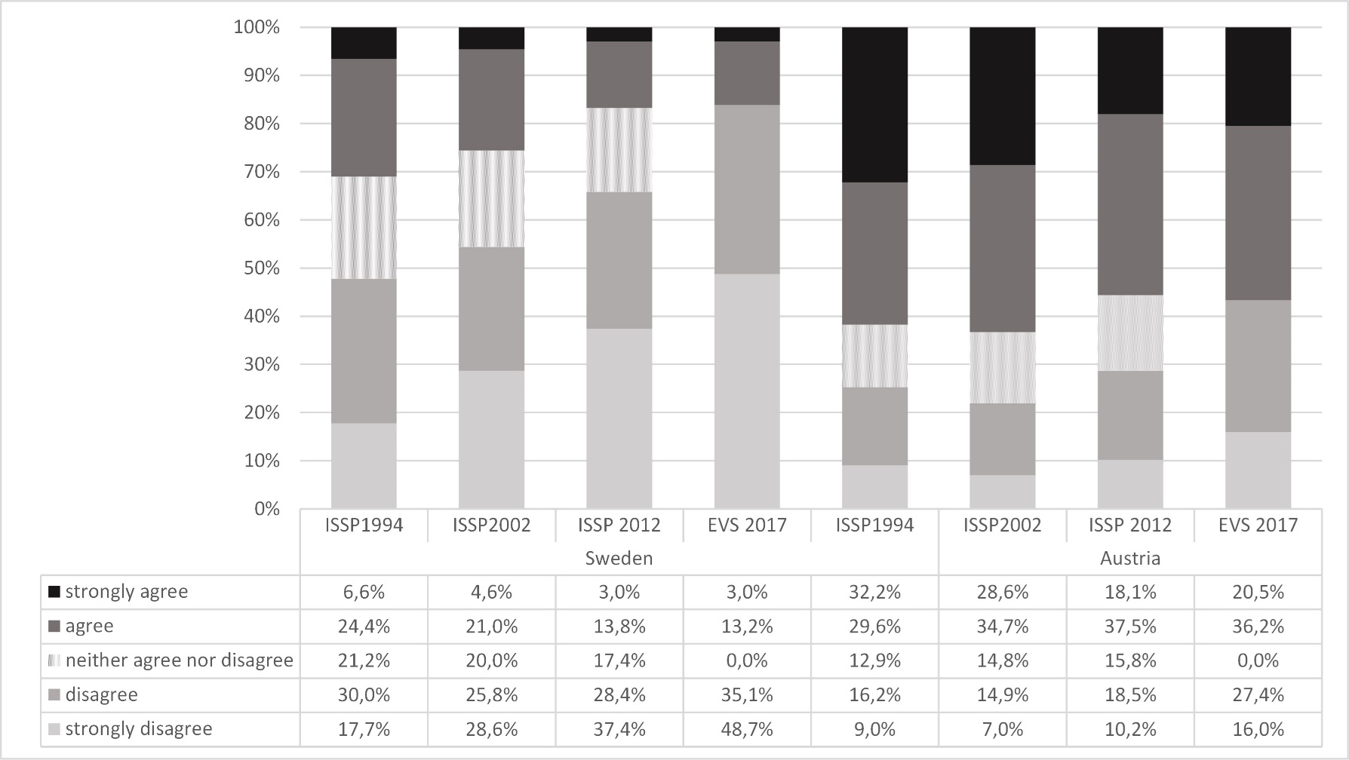
Cultural approach Q 1: All in all, family life suffers when the woman has a full-time job.
Source: European Value Survey 2017; International Social Survey Programme 1994,2002,2012
Notes:
The goal was to work with the most recent data (EVS 2017/18) but also to provide an overview of the changes in time. To achieve this, data from the ISSP also had to be used as some indicator variables in the EVS 2017/18 were not previously collected.
Statistical Methods
Since attitudes and values are measured in an ordinal scale (ranging from strongly agree to strongly disagree), we test for differences using Mann-Whitney U-test with a level of significance ∝≤0,05. For correlations analysis we use Spearmans Rho, where we define weak effects as r_sp≤0,10 and strong effects as r_sp≥0,50. Values in between are defined as average.

Slide 5
Thank you for your attention!
Further reading:
Dörfler, Sonja (2019): Elterliche Arbeitsteilung in Österreich und Schweden. Die Entwicklung institutioneller und kultureller Rahmenbedingungen von 1990 bis heute. Wiesbaden: Springer VS.
Saxonberg, Steven (2013): From Defamilialization to Degenderization: Toward a New Welfare Typology. Social Policy & Administration, 47(1), 26–48.
Contact:
Dr. Sonja Dörfler-Bolt
Tel: +43(0)1 4277 48904
E-Mail: sonja.doerfler-bolt@oif.ac.at

